Slide 1
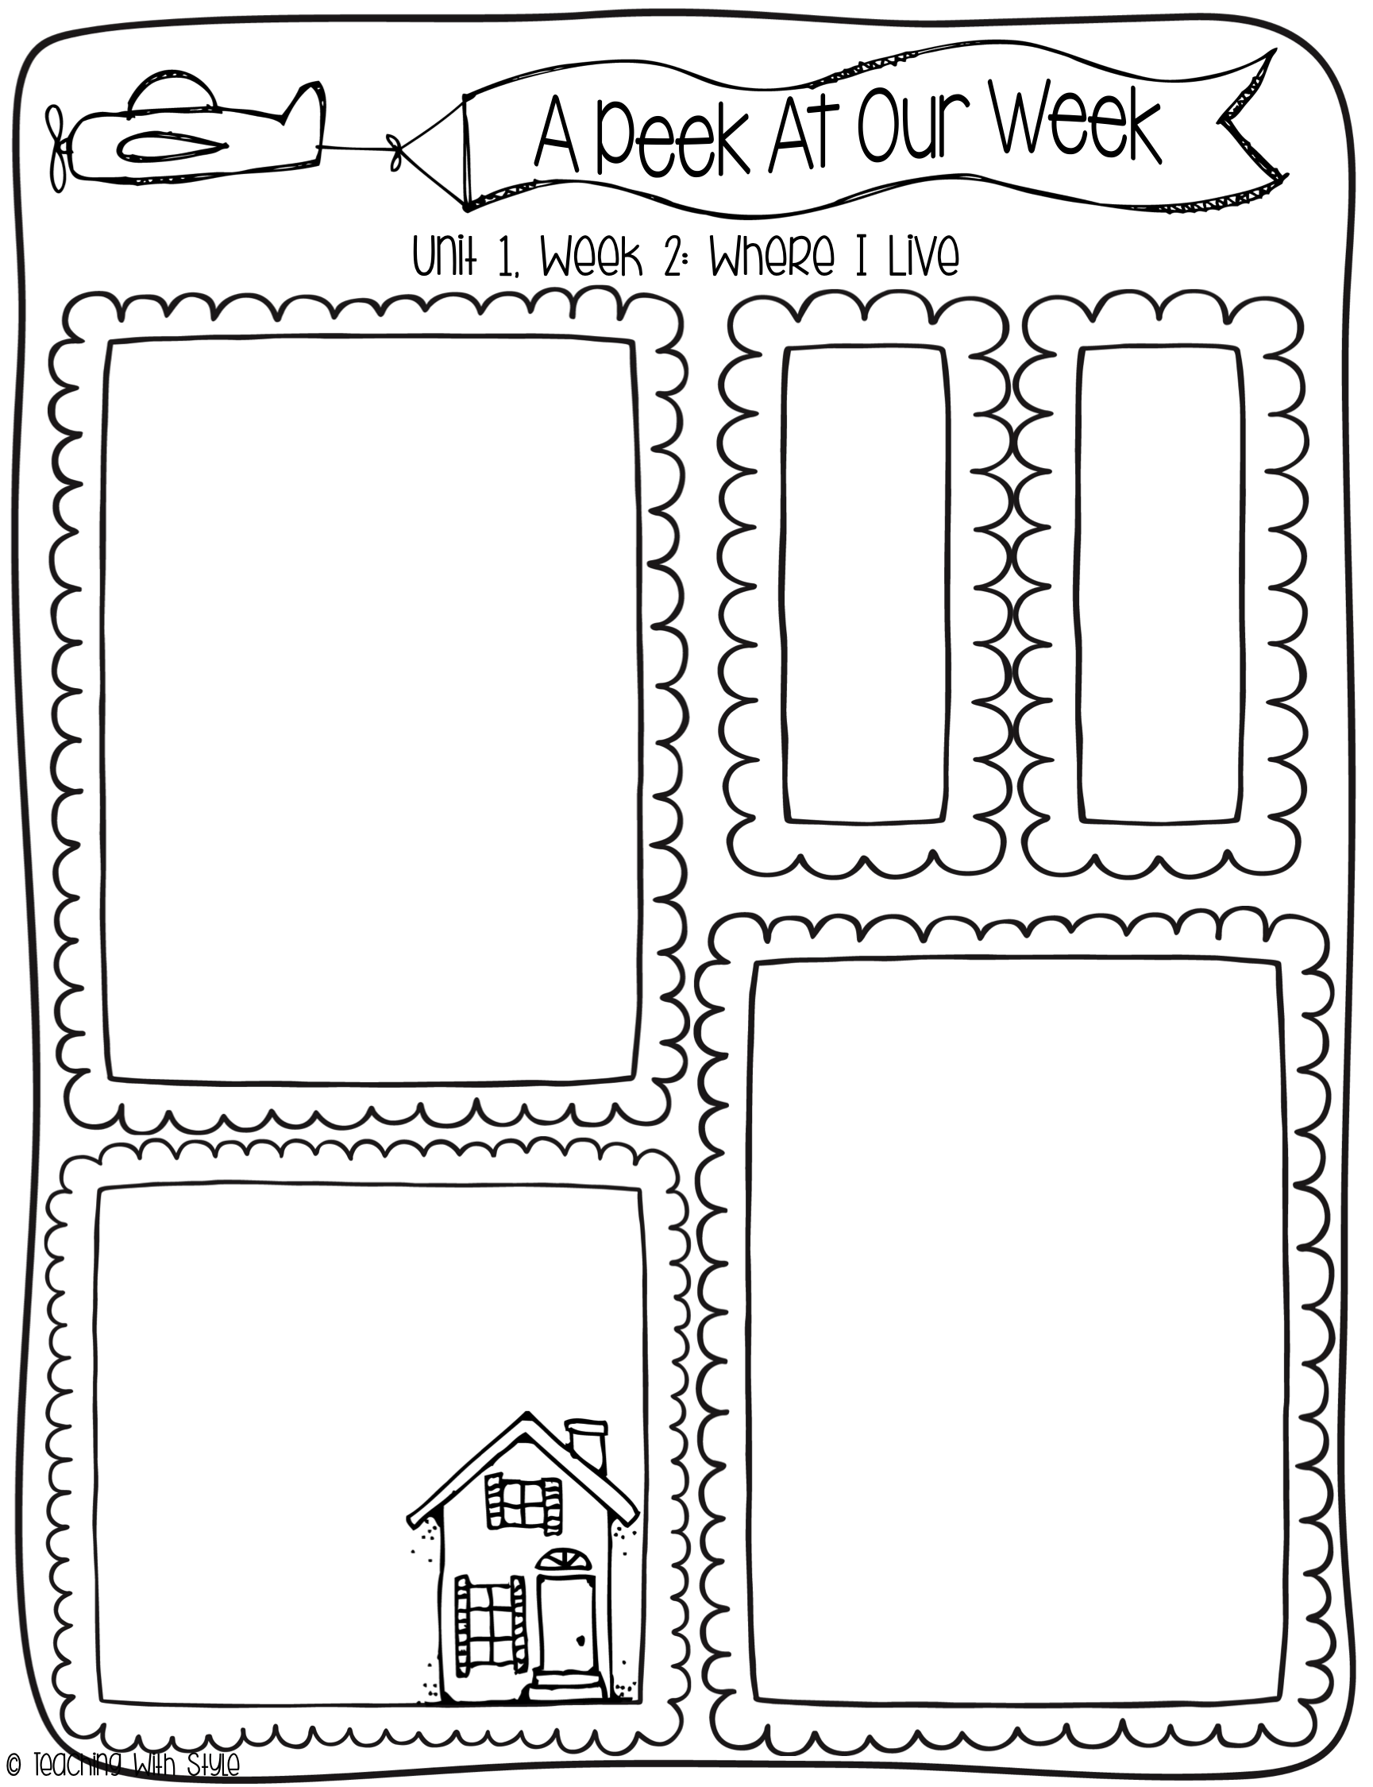
August 25 - 29
What we are learning!
Comprehension Focus:
key details
Word Work:
short I (the sound in insect)
double final consonants
Grammar:
word order in sentences
Math:
addition
-word problems, missing
addends
subtraction
-using a number line
Spelling Patterns
pin
win
hit
sit
miss
kiss
High
Frequency
Words
out
down
up
very
Dates to remember
September 1st
Labor Day (NO SCHOOL)
September 7
Grandhawks Picnic (4:00)
September 11th
Parent/teacher Conferences
September 12th
Skate Night
September 26th
Annual Giving Campaign Party
Reminders
*Join Class Dojo
*Donate to the Annual Giving Campaign
*Graded papers will
be in your child’s
binder on Wednesday
Initial the conduct
sheet EVERY night

